Slide 1
California Housing Market
Prediction
GROUP 2
Team Members:
Saumya Sinha
Mythri Muchamari
Vansh Sharma
Shashidhar Reddy Repala
Sally Wei

Slide 2
Problem Statement
Problem Statement: Housing quality from Investment Perspective
California is on the path to becoming the 4th largest economy in the world, with millions of new residents moving in every year. With new residents moving in there comes a huge demand for housing. California is ranked #2 in states with the highest average home price, according to Forbes.
In this project, we will be building machine learning models to predict how often a house is successfully sold out after it’s been listed and also predict the price of the house depending on quality level provided or predicted from the previous model.
We will be taking mortgage rate into account for the predictions.
Following an increase in mortgage rates, demand for buying a house decreases and inversely the amount being sold increases, which also leads to a drop in housing price. Our goal is to find out if this holds true.
Data Source: Redfin/Kaggle, FRED Economic Data
Expected Output: Quality Level (High, Medium, Low)
DATA FIELDS
property_type,
median_sale_price
median_list_price
median_ppsf
median_list_ppsf
homes_sold
pending_sales
new_listings
inventory
months_of_supply
median_dom
avg_sale_to_list
sold_above_list
price_drops
off_market_in_two_weeks
parent_metro_region
parent_metro_region_metro_code
MORTGAGE30US

Slide 3
Motivation
Selling or buying a house has always been a challenging task for people. It’s a huge financial and emotional investment which creates a lot of stress and anxiety.
In a high inflation situation like today’s, it is difficult to buy a house due to high mortgage rates, and makes it equally difficult for a seller to sell their property.
There is always the risk of getting duped by real estate agent or third party seller.
When making investments in a housing market with inflated prices, it becomes difficult to make judgment on a price, especially in California.
Hence, we need to know more about the state of the market by estimating how often a house is sold after it’s listed depending on its final price, price per square feet (PPSF), locality, mortgage rate, and many other features .

Slide 4
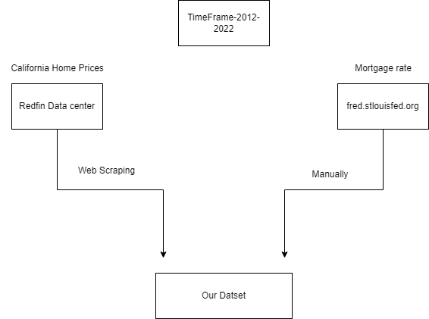
Data Collection

Slide 5
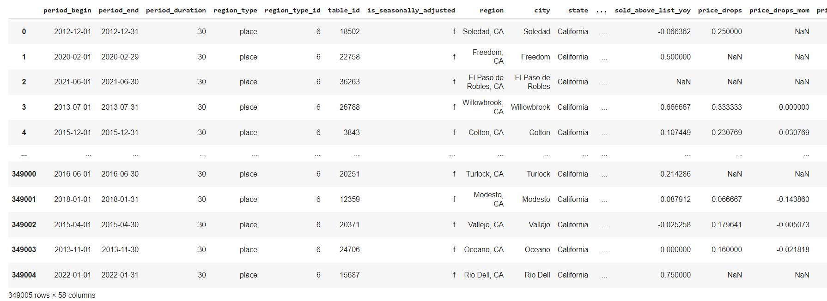
Our Dataset
California home prices data are taken from the Redfin data center by web scraping. It includes California home prices in every county from 2012-2022

Slide 6
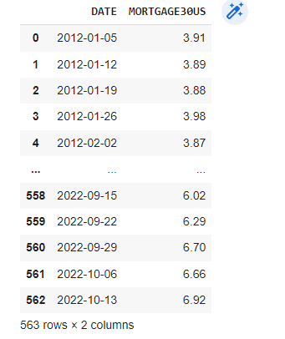
Our Dataset
Mortgage data is taken from fred.stlouisfed.org. It contains the average 30-year fixed mortgage rate across the United States from 2012-2022

Slide 7
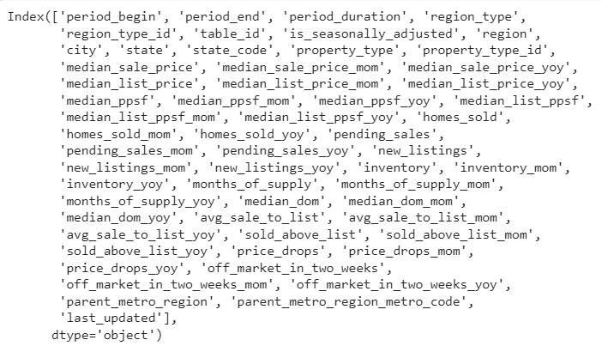

Our Dataset

Slide 8

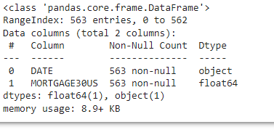
Our Dataset

Slide 9
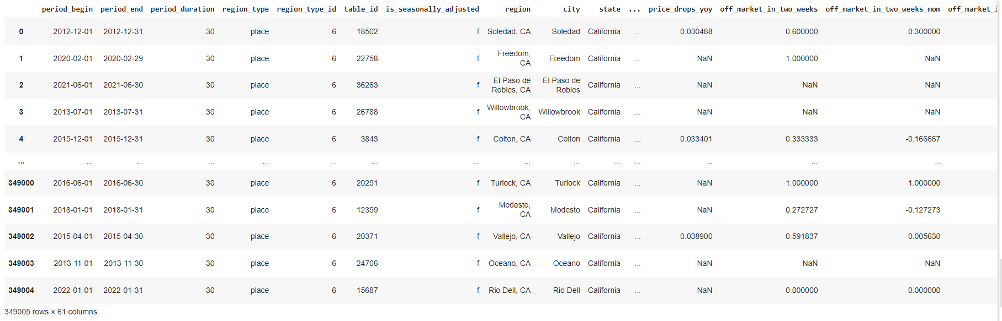
Data Preparation
We combined our two datasets using pandas

Slide 10

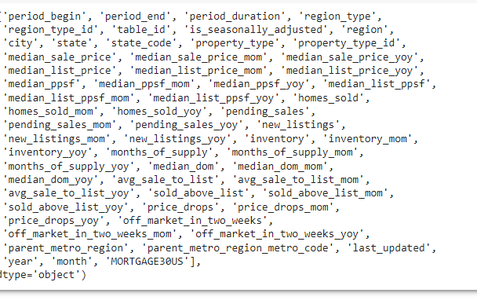
Data Preparation

Slide 11
Steps for Data preparation
Steps for merging the datasets:
Converted time series data to pandas.Timestamp in both the datasets
Extracted “Month’ and “Date” from Timestamp and made “Month” and “Date” columns in both datasets.
Since mortgage rate was changing in a month so took average and grouped them according to month and year
Combined both datasets using LEFT JOIN on “Month” and “Year”

Slide 12
Data Cleaning
Filtered out derived columns from the housing dataset to arrive at only the features we are interested in.
Modified features to represent them with appropriate data types.
Performed imputation for the features with missing values using mean and mode for continuous and categorical fields respectively.
Eliminated/checked for redundant data in the dataset.
Performed one-hot encoding to encode the categorical features using dummy feature columns.

Slide 13
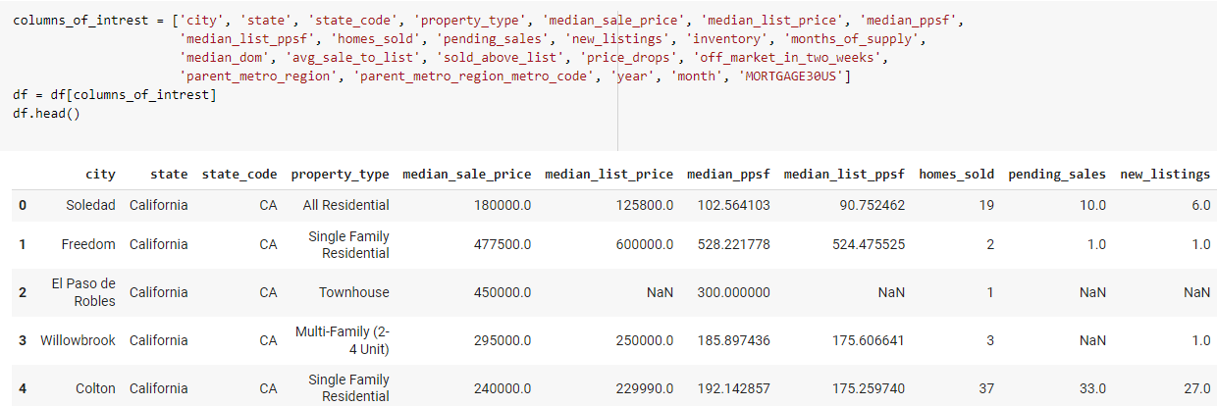
Data Cleaning
Data set, after selecting the columns of interest.

Slide 14
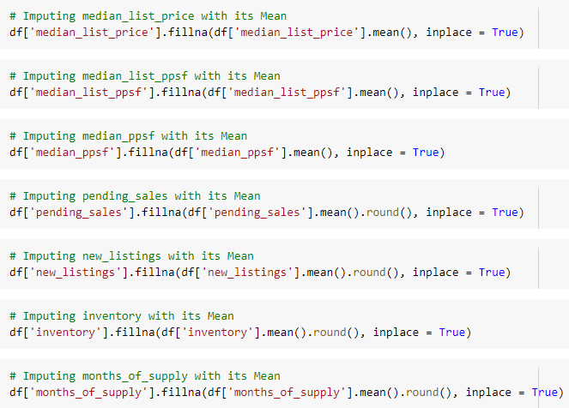
Data Cleaning
Imputing the Null Values with its central tendency of the feature

Slide 15
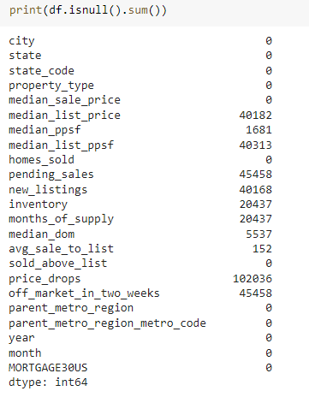
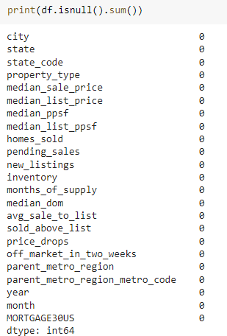
Data Cleaning
Results, after performing imputation.

Slide 16
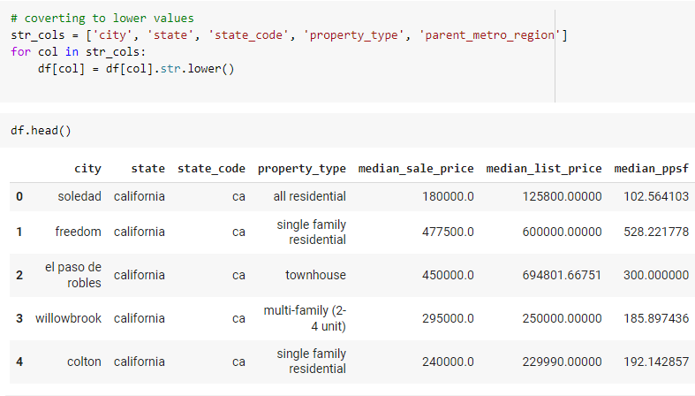
Data Cleaning
Converting strings from upper case to lower case.

Slide 17
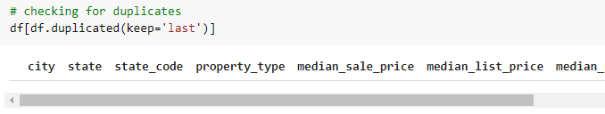
Data Cleaning
Checking for the duplicates

Slide 18
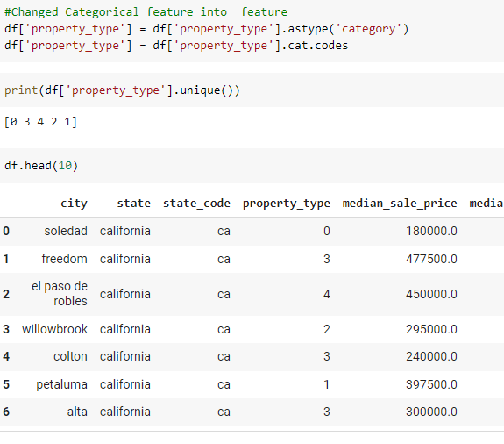
Data Cleaning
Performing encoding method to convert the
categorical values to numericals.

Slide 19
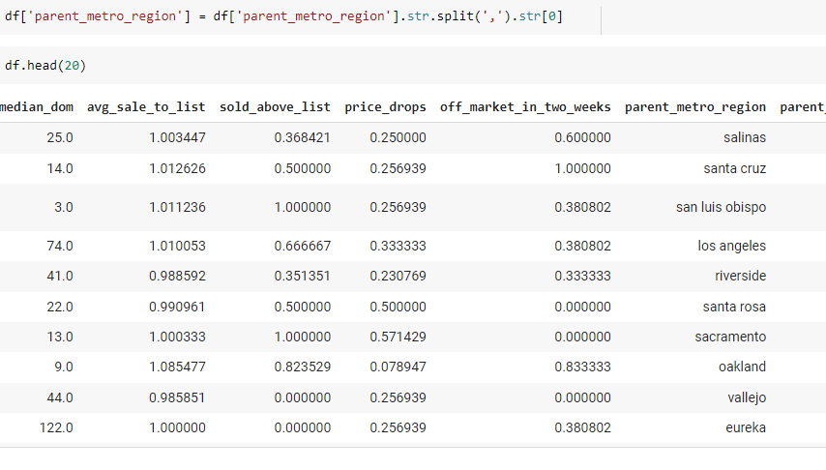
Data Cleaning
Cleaning the redundant text fields.

Slide 20
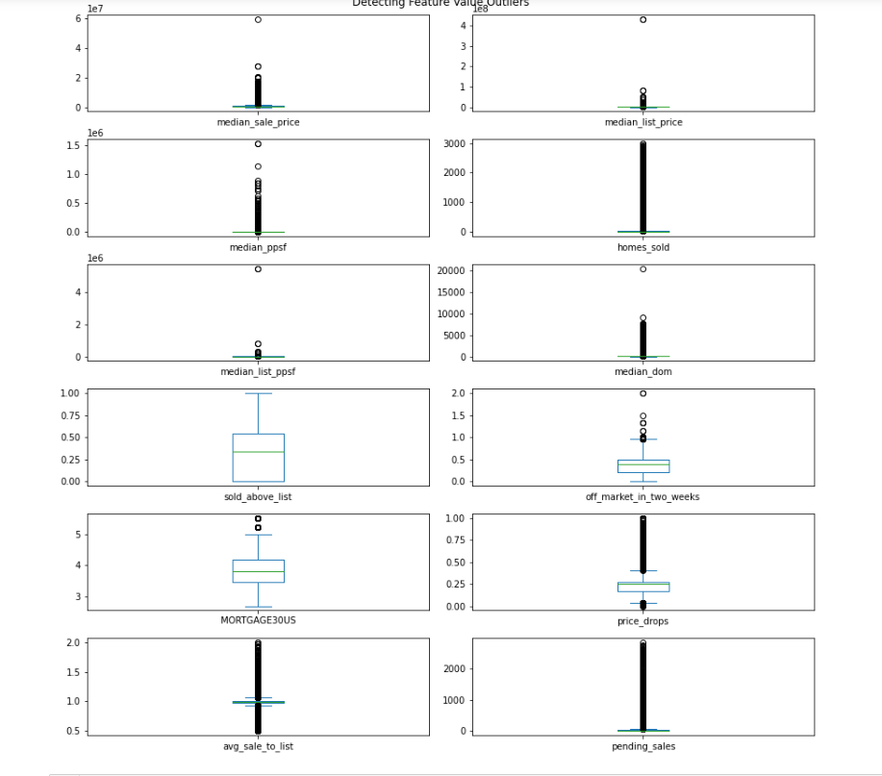
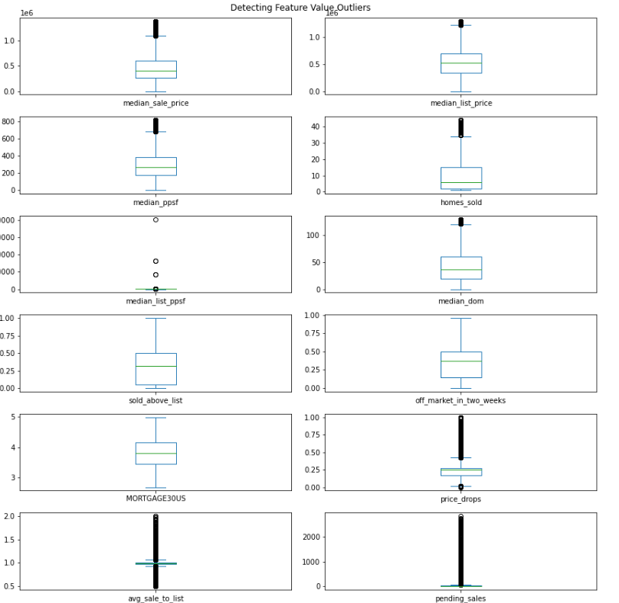
Exploratory Data Analysis
Changed categorical feature into numerical feature(Property Type)
Checked and removed outliers
With Outliers
Without Outliers

Slide 21
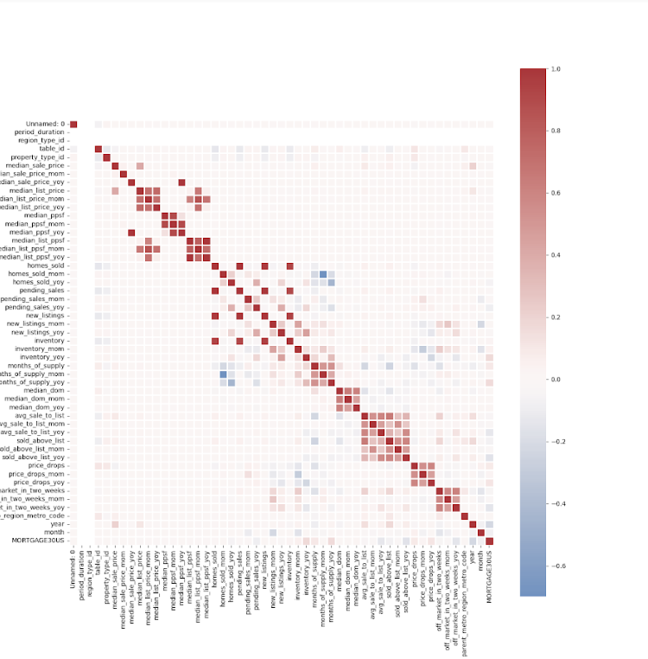
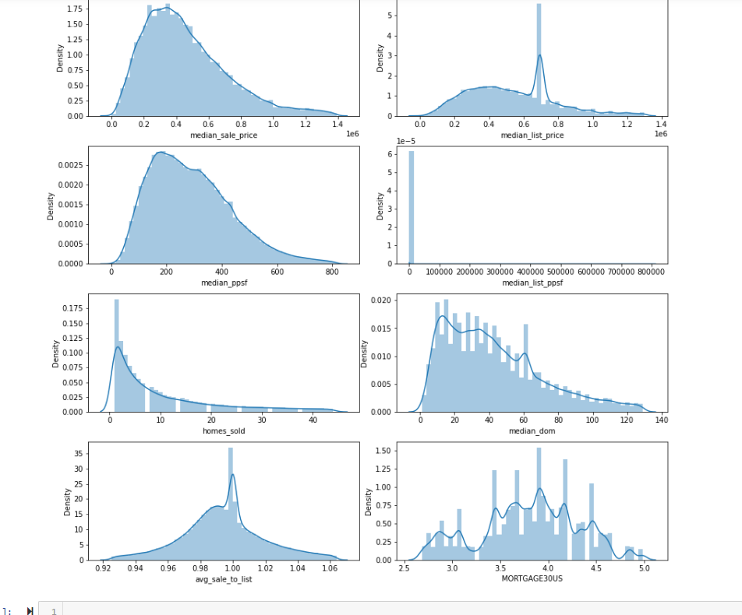
Correlation matrix and Data Distribution
Correlation matrix heatmap for all the features
Data distribution visualization after removing outliers.
Correlation Matrix
Data Distribution after removing outliers

Slide 22
Future work
Building the Models.
Evaluation and cross validation of each models
Deployment
Final Report

Slide 23
Thank You!!
Any Questions?

